Slide 1

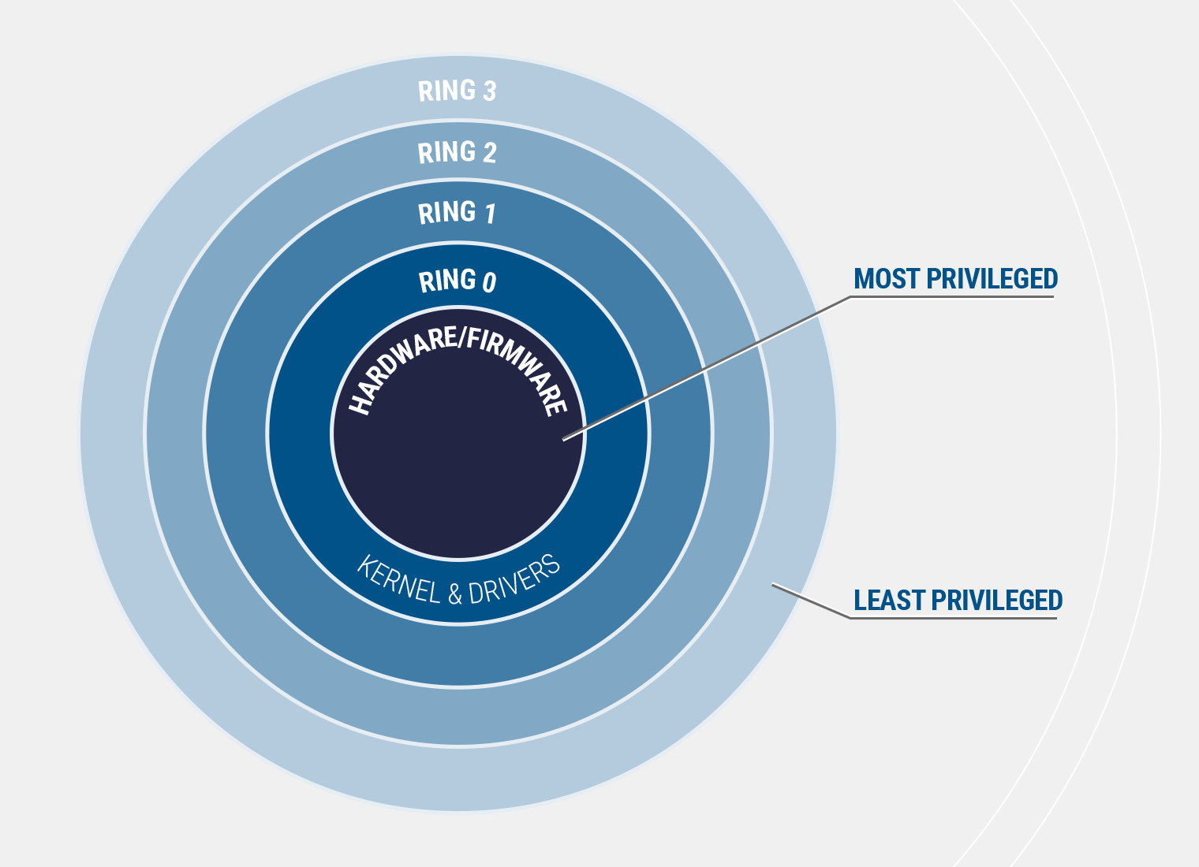


Privilege Escalation using Metasploit
Name-Sabyasachi Banerjee

Slide 2


Project Description
1.First step is to Gain initial foothold of the system . This can be done by generating appropriate payload and deliver it to the victim. We are assuming victim’s pc has windows.
2.We will set up the Reverse listener in Metasploit , and as soon as the victim clicks the payload, we will get a reverse shell in our kali machine . But the session has normal user privileges . We will background the session.
3.Now using appropriate Metasploit module we will try to find privilege escalation vectors. We will exploit one of them using the session id that was previously put into Background.
4.Now we try to do dll injection and after that when the malicious dll file runs ,we will get.

Slide 3

Workflow Diagram
Crafting a payload using msfvenom
Changing the payload icon to a pdf file
Spoofing the extension from .exe to .pdf
Compressing the file
Starting the apache web server
We will get a privileged shell
We will exploit a local privesc vulnerability using dll injection
Using Metasploit we will try to find local escalation vectors
Once the file is executed we get the reverse shell
but as a regular shell
Social Engineer the victim and deliver the file

Slide 4

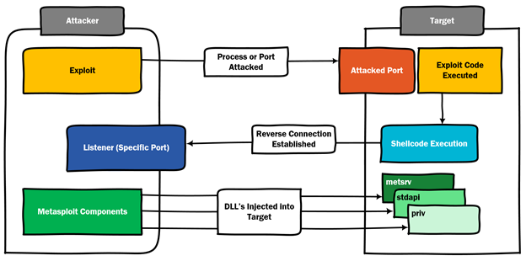

Slide 5
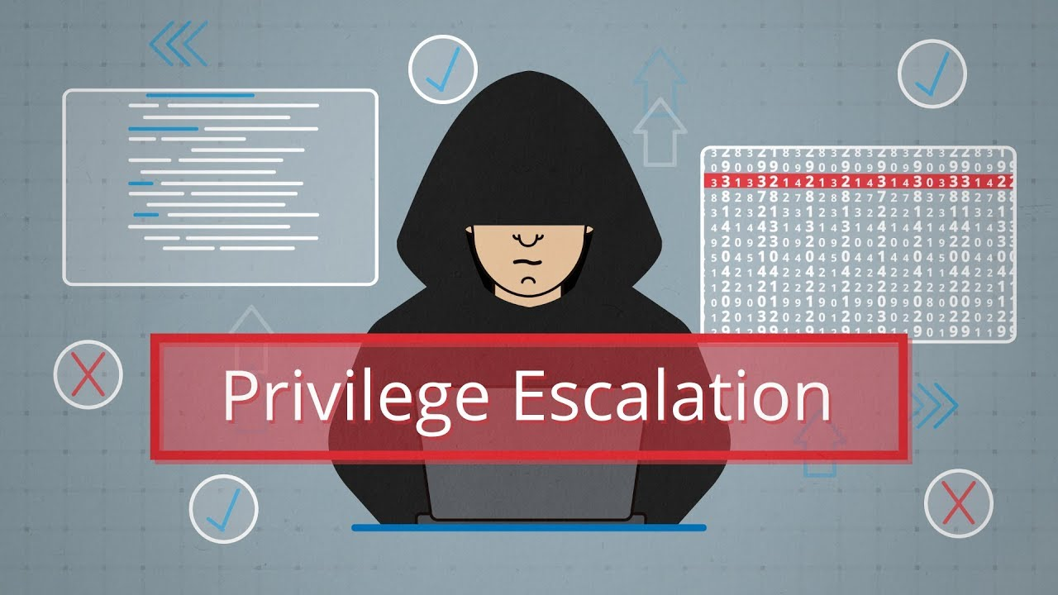
Thanks!
Any questions?
Find me at sabyasachibanerjee415@gmail.com

